Slide 1
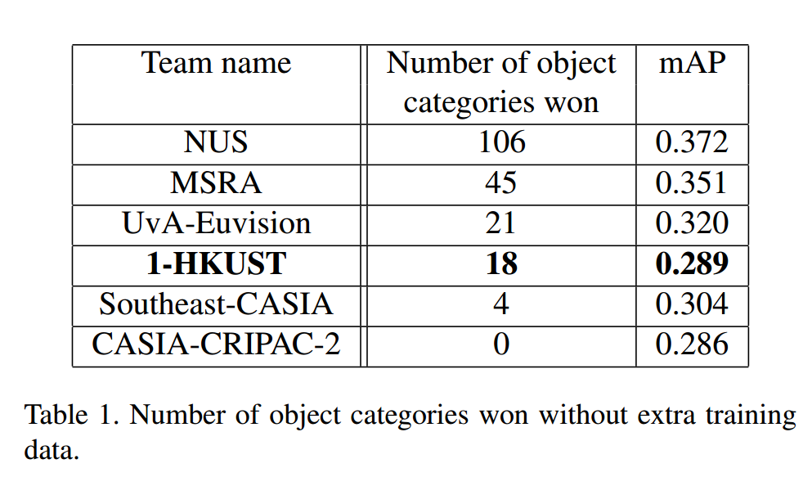

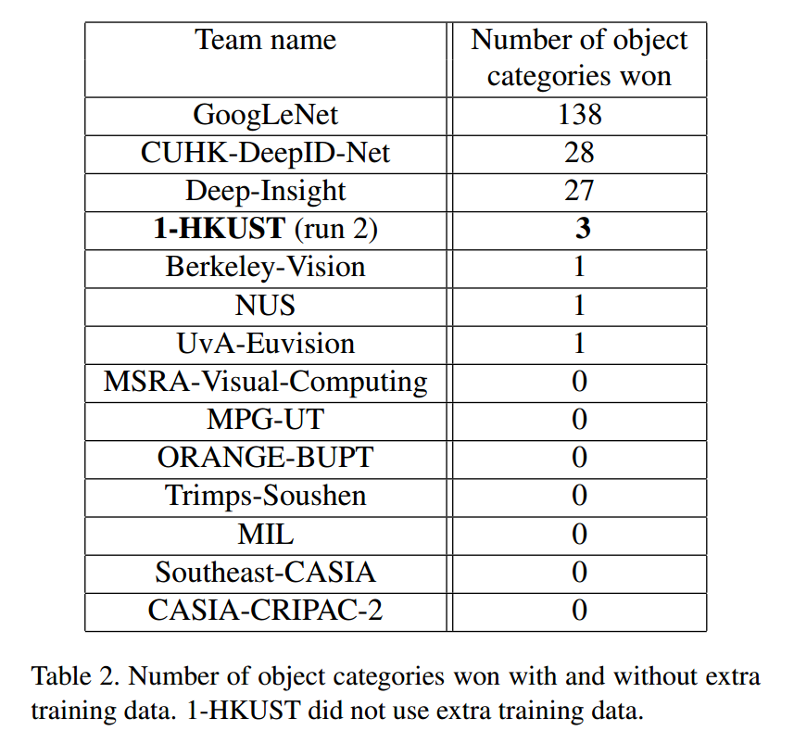
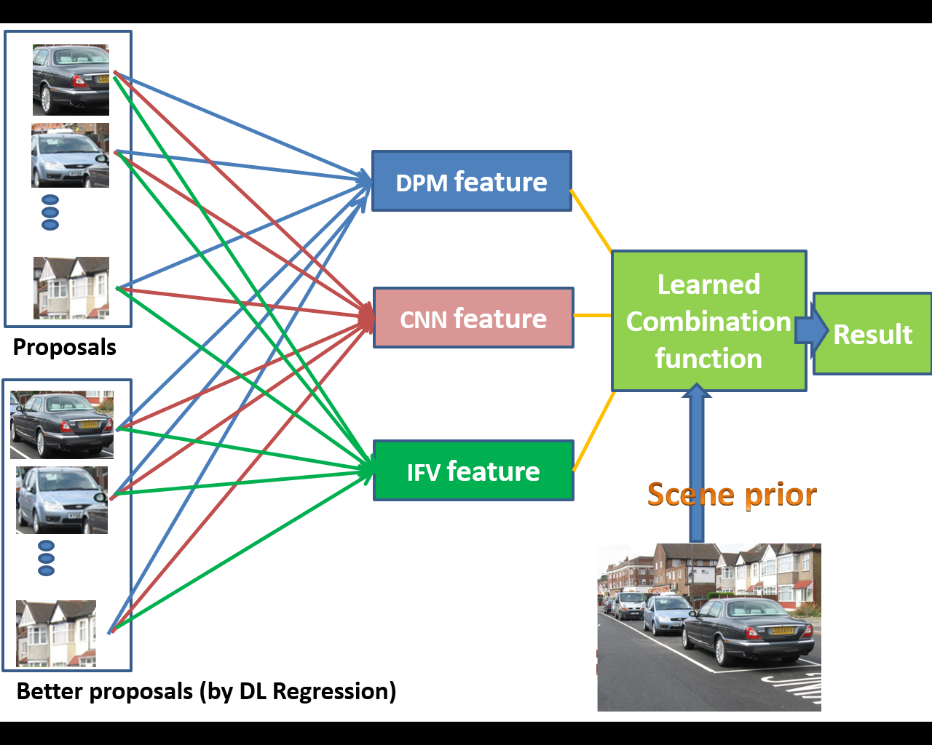
Large Scale Visual Recognition Challenge 2014
New York Times article on ILSVRC2014
Notes:
Our team 1-HKUST participated in one of the best known big challenge to date: the Large Scale Visual Recognition Challenge 2014, which was featured in the NY Times. Our group was placed 4th among all the participating teams, in terms of mean average precision and number of object categories won.

Slide 2
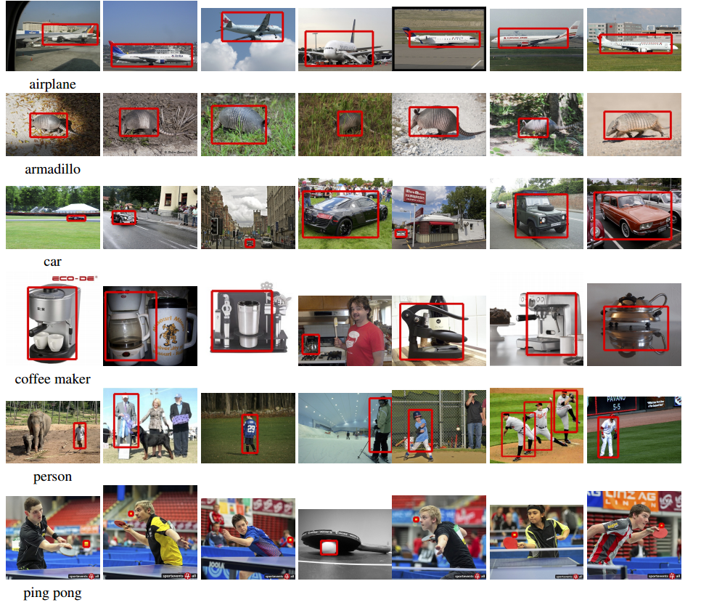
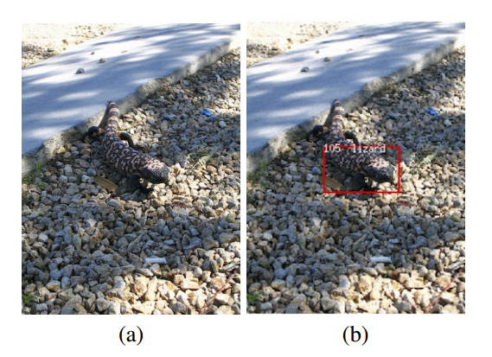
Notes:
Here are some sample detection results.
(On click) Here is an interesting one: some people found it hard to detect the lizard ☺

